Slide 1
Guide to Data and Information Sharing Workflows Across the Life Cycle of Transportation Assets
August 1, 2016

Slide 2
Project Status Update
Process maps:
Draft PM of sign - new construction/reconstruction
Draft PM of sign - replacement
Draft PM of sign - maintenance
Exchange Requirements (ERs) and ER matrix
Draft ERs for seven identified exchange scenarios
Draft ER matrix

Slide 3
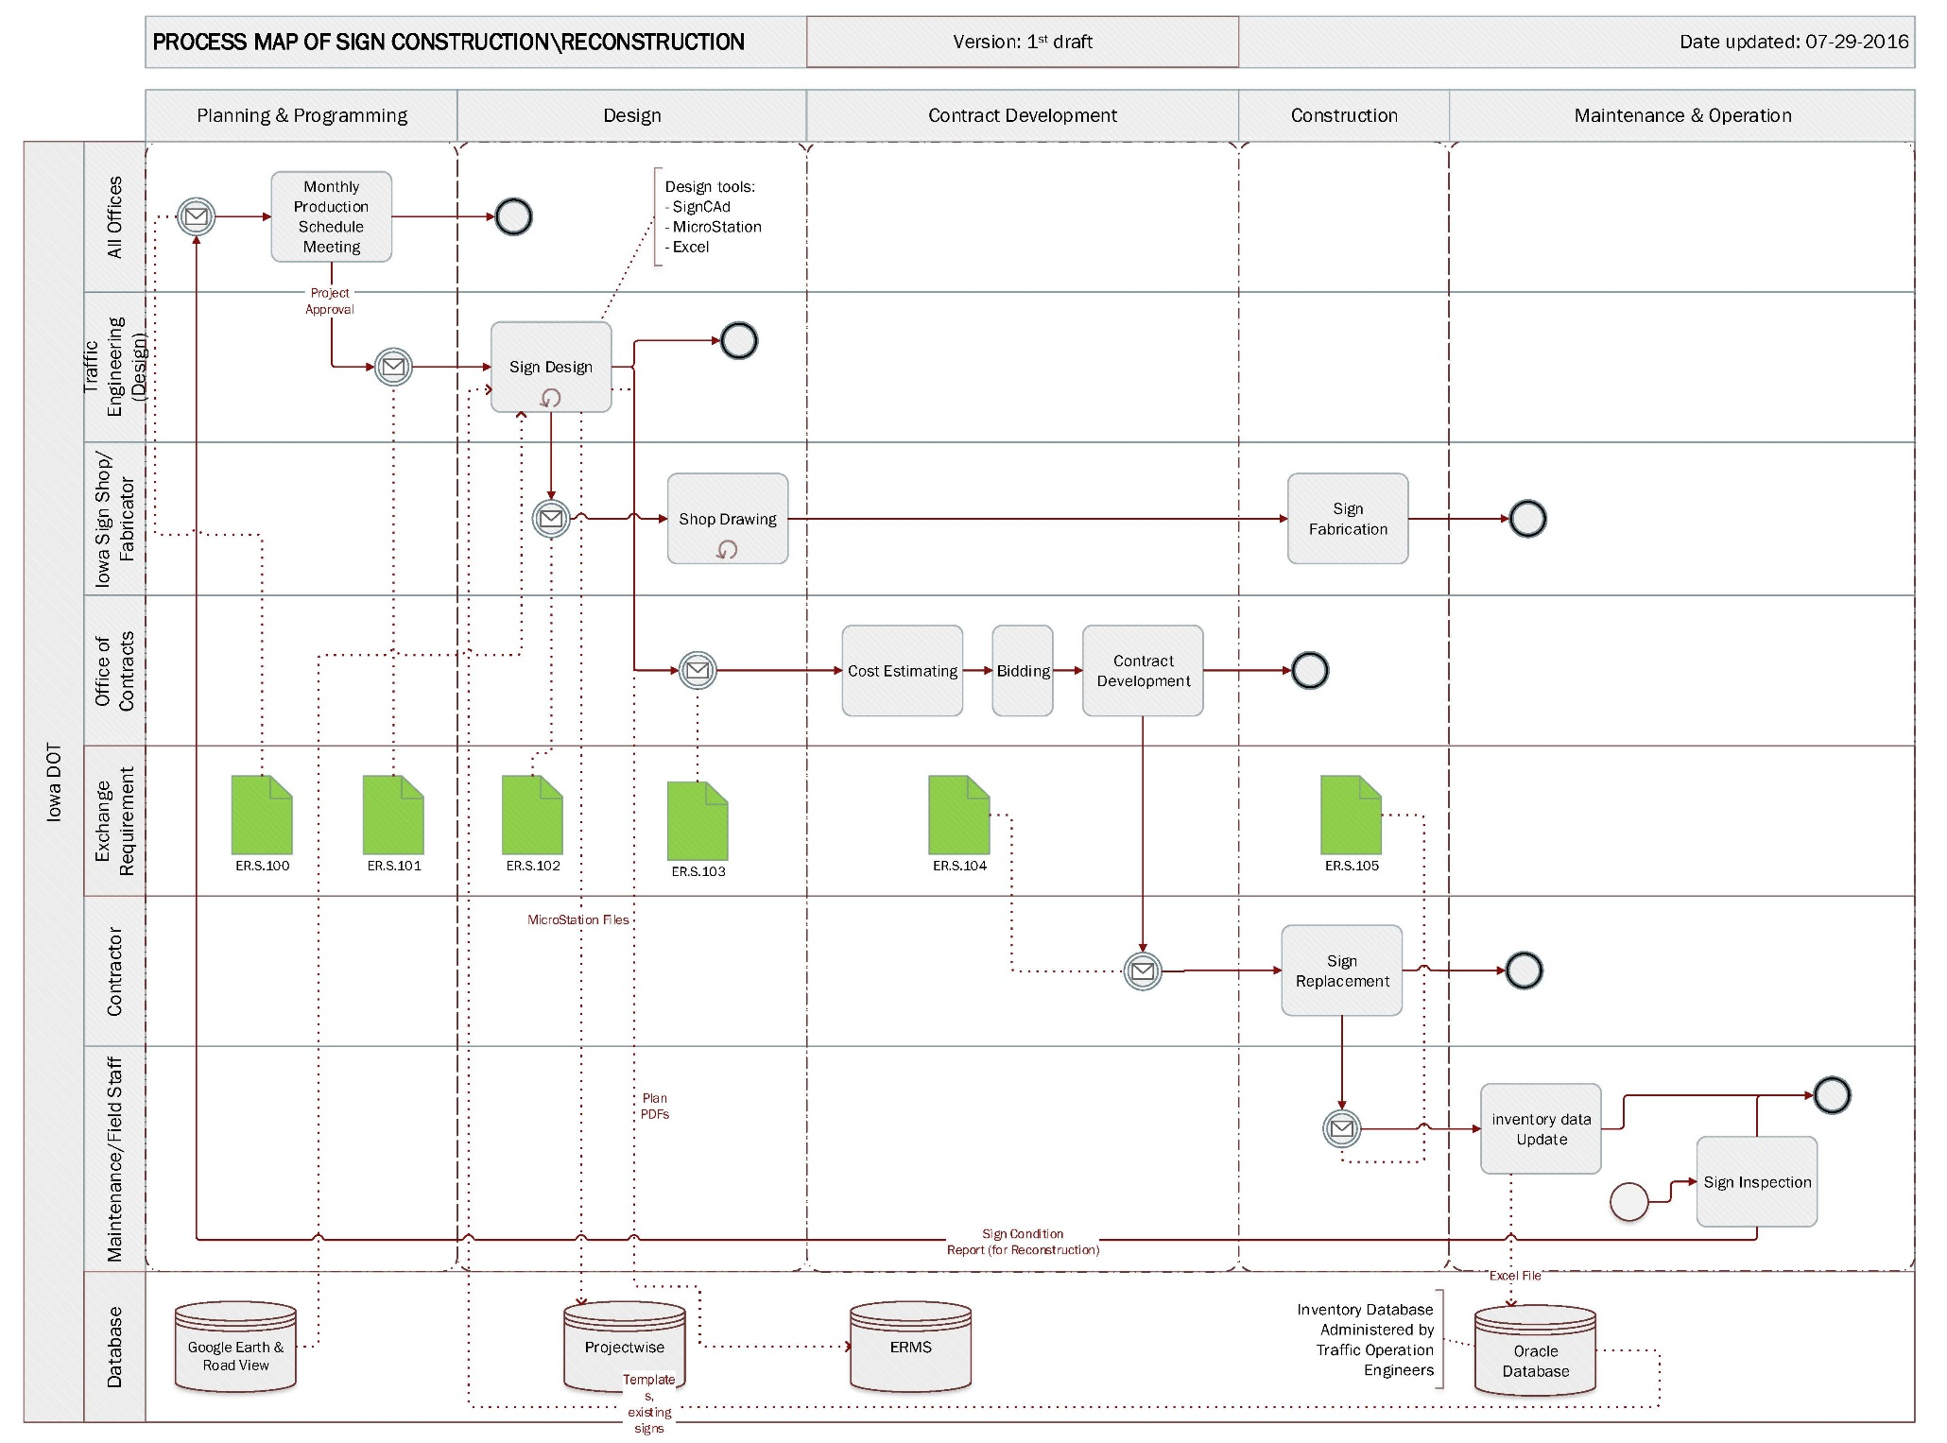
Process map
PROCESS MAP
Phase
Task
Actor
ER
Database

Slide 4
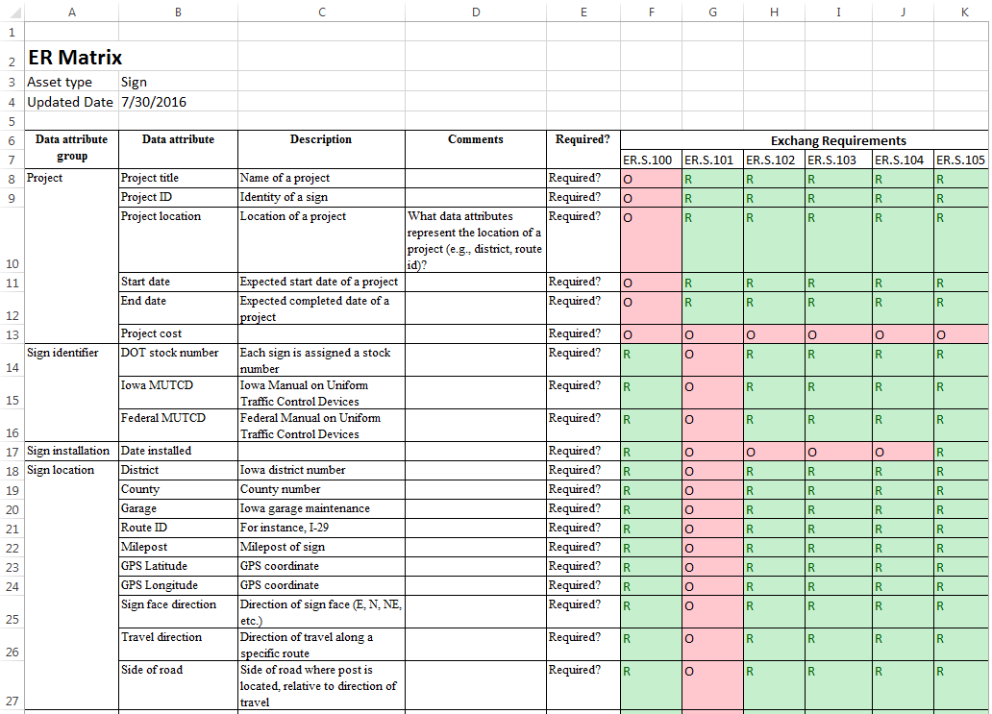

ER Matrix
Data Attributes
ERs

Slide 5
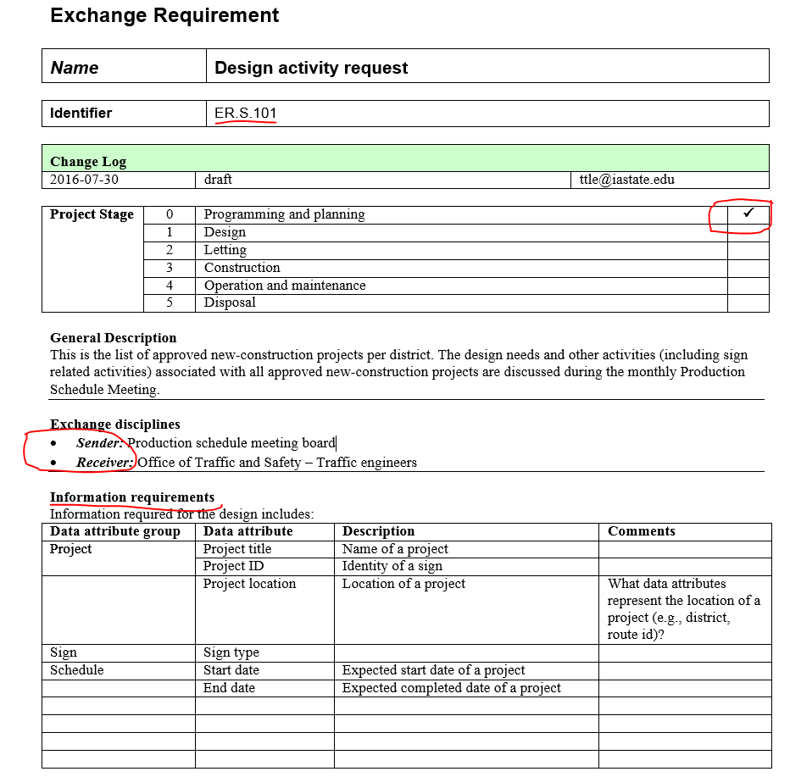
Detailed Exchange Requirement
Information included in an ER
Project phase
Data sender
Data receiver
Data required

Slide 6
Work plan
Revise PMs, ERs and ER matrix based on feedback from Iowa DOT
Develop preliminary process maps for guardrails
Schedule individual meetings for guardrails

